Slide 1
Software Quality Assurance and Testing Technology
2nd Semester, Spring 2022
Xiaoping CHE (xpche@bjtu.edu.cn)
Associate Professor
School of Software Engineering
Beijing Jiaotong University

Slide 2
Rules
Project 20%
Assignments 40%
Final Exam 40%

Slide 3
How
16 Weeks Plan
Week 1: The basic concepts and theories of testing
Week 2-3: Principles of Testing
Week 4-5: Test Cases & Black Box Testing
Week 6-9: White Box Testing
Week 10-11: Integration Testing
Week 12： Usability Testing and System Testing
Week 13: System Testing and Security Testing
Week 14: Quality Assurance in General

Slide 4

How
References
Ron Patton, Software Testing (2th Edition)
Glenford J. Myers, The Art of Software Testing (3rd Edition)
Gerald M. Weinberg, Perfect Software

Slide 5
Software Quality
Topics in Testing Software
Software Quality

Slide 6
What is Software Quality Assurance?

Slide 7
What is Quality?
Quality – developed product meets it’s specification
Problems:
• Development organization has requirements exceeding customer's specifications (added cost of product development)
• Certain quality characteristics can not be specified in unambiguous terms (i.e. maintainability)
• Even if the product conforms to it’s specifications, users may not consider it to be a quality product (because users may not be involved in the development of the requirements)

Slide 8
What is Quality Management?
Quality Management – ensuring that required level of product quality is achieved
• Defining procedures and standards
• Applying procedures and standards to the product and process
• Checking that procedures are followed
• Collecting and analyzing various quality data
Problems:
• Intangible aspects of software quality can’t be standardized (i.e elegance and readability)

Slide 9
What are SQA, SQP, SQC, and SQM?
SQA includes all 4 elements…
Software Quality Assurance – establishment of network of organizational procedures and standards leading to high-quality software
Software Quality Planning – selection of appropriate procedures and standards from this framework and adaptation of these to specific software project
Software Quality Control – definition and enactment of processes that ensure that project quality procedures and standards are being followed by the software development team
Software Quality Metrics – collecting and analyzing quality data to predict and control quality of the software product being developed

Slide 10

Software Development Process Spiral
Top-Down Design Model
IPDS
Software Development Phases

Slide 11
Software Development Cycle
Software Development Phase
• Software requirements
• Preliminary Design
• Detailed Design
• Code
• Unit Test
• Software integration
• Software Component Test
• Software System Test
• Maintenance and Support
End product
• SRS, IRS
• SDD, PQT/FAT/SAT Plans & Proc.’s, ICD, IDD
• PDL, User Manuals
• Code, UT Plan & Proc.’s
• UT Results
• VDD
• PQT Report
• FAT & SAT Reports
• Updates

Slide 12
Software Development Cycle (contd.)
Req.
Maint
PD
DD
SAT
FAT
CUT
PQT
Int

Slide 13
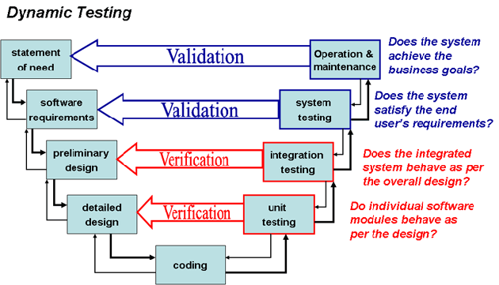
Software Development Cycle (contd.)

Slide 14
Software Quality Assurance
Element I

Slide 15
Why are Standards Important?
• Standards provide encapsulation of best, or at least most appropriate, practice
• Standards provide a framework around which the quality assurance process may be implemented
• Standards assist in continuity of work when it’s carried out by different people throughout the software product lifecycle
Standards should not be avoided. If they are too extensive for the task at hand, then they should be tailored.

Slide 16
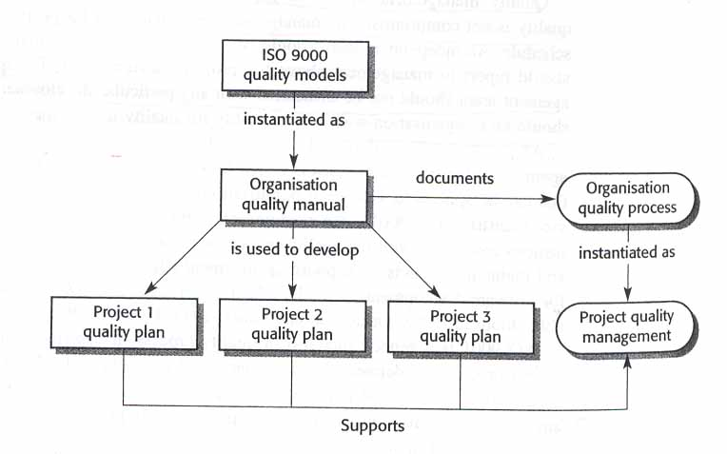
SDS a Simplistic approach
In most mature organizations:
• ISO is not the only source of SDS
• Process and Product standards are derived independently
• Product standards are not created by SQA

Slide 17
Process Standards
Process Standards – standards that define the process
which should be followed during software development
CMMI (Capability Maturity Model Integration)
ISO
CMM
CMMI
Organizational
Quality Manual
Organizational
SD Process STD’s
IPDS
Project SQP
Project SD Process STD’s
(SDP, IP, Method Sheets)
Project SCMP

Slide 18
Product Standards
Product Standards – standards that apply to software product being developed
ISO
STD’s
MIL/ Industry
STD’s
Organizational
Product STD’s
COTS
STD’s
Project Product STD’s (SDP, IP, Method Sheets)

Slide 19
Quality Models

Slide 20
ISO - 9000 Elements
Quality System Requirements
Management Responsibility
Quality system
Contract review
Design Control
Document control
Purchasing
Purchaser supplied product
Product identification and traceability
Process control
Inspection and testing
Inspection, measuring and test equipment
Inspection and test status
Control of non-conforming product
Corrective action
Handling, storage, preservation, packaging and shipping
Quality records
Internal quality audits
Training
Servicing
Statistical techniques
Software Quality Responsibilities
Management Responsibility
Quality system
Contract review
Design Control
Document control
Purchasing
-
Product identification and traceability
Process control
Inspection and testing
-
Inspection and test status
-
Corrective action
-
Quality records
Internal quality audits
Training
-
Statistical techniques

Slide 21
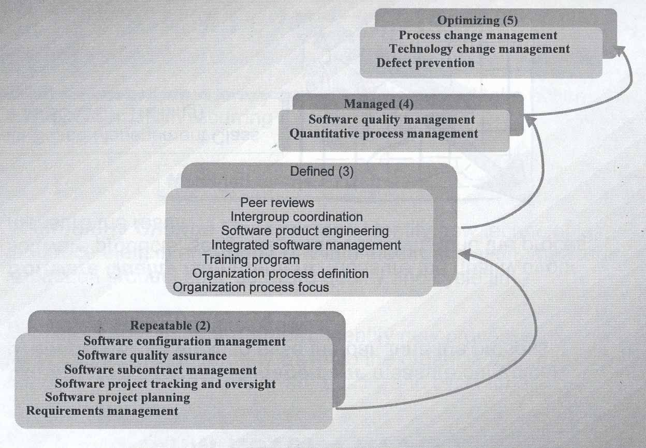
Capability Maturity Model KPA’s

Slide 22
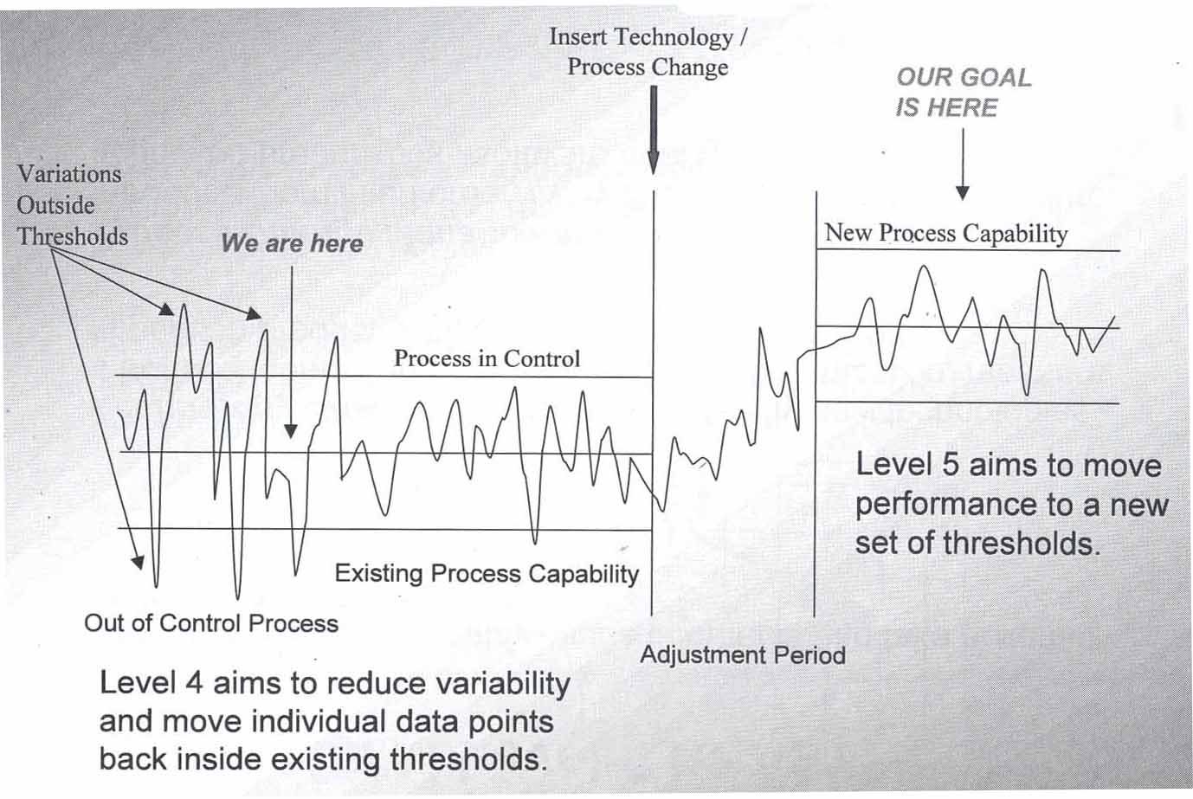
CMM Level’s 2-5

Slide 23
Documentation

Slide 24
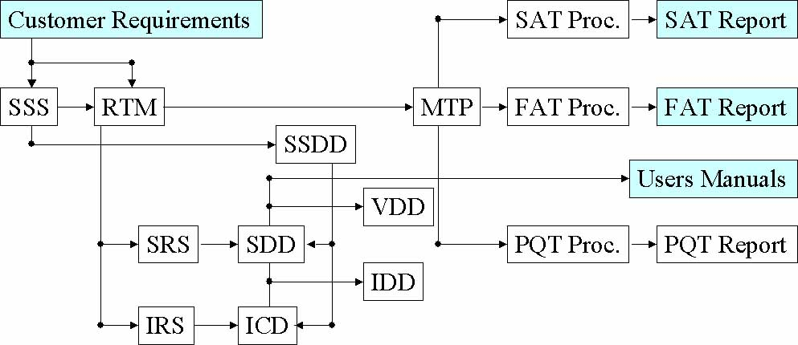
Documentation Hierarchy
• Documents are not the only tangible way of representing software products. The working software system is the most tangible way of representing software products.
• Documents are the best way to ensure software products’ understandability

Slide 25
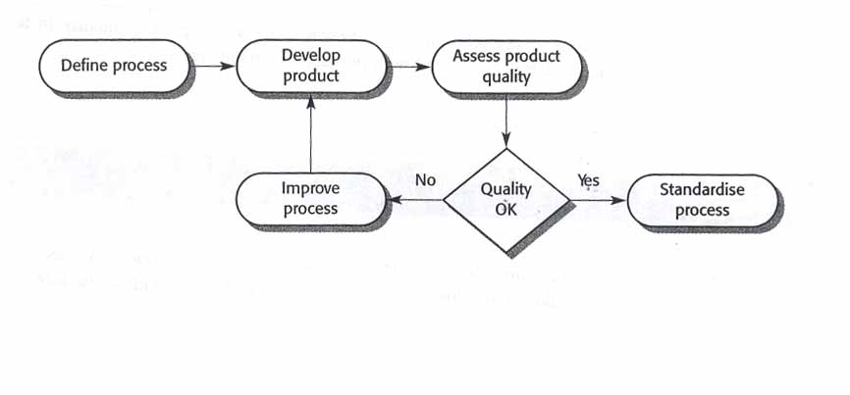
Process and Product Quality
Quality of development process directly affects the quality of
delivered products.
This is the factory approach. It doesn’t work because software is
designed rather then manufactured.

Slide 26
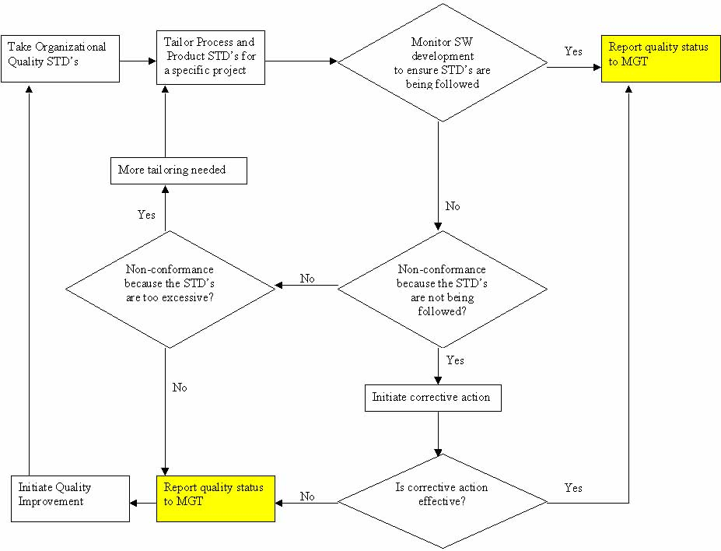
Process and Product Quality Creative Approach
• Quality Improvement – identifying good quality products,
examining the processes used to develop these products, and then
generalizing these processes so that they can be applied everywhere

Slide 27
Continuity and Independence of SQA
• Software Quality Assurance team must be independent in order to take an objective view of the process and report problems to senior management directly
• If prescribed process is inappropriate for the type of software product which is being developed, then it should be tailored
• The standards must be upheld no matter how small the task. Prototyping doesn’t mean no standards. It means tailored standards.
• Quality is FREE, if it’s Everyone’s Responsibility!

Slide 28
Software Quality Planning
Element II

Slide 29
Software Quality Plan
Tailoring - SQP should select those organizational standards that are appropriate to a particular product
Standardization - SQP should use (call out) only approved organizational process and product standards
If new standards are required a quality improvement should be initiated
Elements - SQP elements are usually based on the ISO-9001 model elements
SQP is not written for software developers. It’s written for SQE’s as a guide for SQC and for the customer to monitor development activities
Things like software production, software product plans and risk management should be defined in SDP, IP
Quality Factor’s shouldn’t be sacrificed to achieve efficiency. Don’t take the job if quality process can’t be upheld

Slide 30
Software Quality Control
Element III

Slide 31
Methods of Software Quality Control
SQC involves overseeing the software development process to ensure that the
procedures and STD’s are being followed
The following activities constitute SQC:
• Quality Reviews - in-process reviews of processes and products
Reviews are the most widely used method of validating the quality of processes and products. Reviews make quality everyone's responsibility. Quality must be built-in. SQE is responsible for writing Quality Engineering Records (QERs) documenting their participation in these reviews.
• Tests - end-result verifications of products. These verifications are conducted after the software has been developed. Test procedures are followed during conduct of these activities. SQE is responsible for keeping the logs and some times for writing the test report.
• Quality Audits - in-process verifications of processes. These audits are conducted periodically (twice a month) to assess compliance to the process STD’s.

Slide 32
Quality Reviews
• Peer reviews - reviews of processes and products by groups of people. These reviews require pre-review preparation by all participants. If a participant is not prepared, then the review is not effective. This type of review requires participation of the SQE, moderator, recorder, author(s), and one or more critical reviewers. All issues found during these reviews are documented on AR forms.
• Walkthroughs - reviews of products by groups of people mostly without preparation. For example a requirements traceability review is a walkthrough. It involves tracing a requirement from customer requirements to the test procedures. All issues found during these reviews are documented on CAR forms.
• Desk inspections - reviews of products by individuals. These reviews involve people reviewing products by themselves (not in a group) and then submitting their comments to the author(s). The issues found during these reviews are treated in informal manner.

Slide 33
Tests
• Engineering Dry-run - test conducted by engineering without SQE. These tests include Unit Tests and engineering dry-runs of the formal tests. These engineering dry-runs are used to verify correctness and completeness of the test procedures. Also, these is the final engineering verification of the end-product before sell-off to SQE. All issues found during these tests are documented on STR forms.
• SQE Dry-run - test conducted by SQE. These tests include PQT, FAT and SAT dry-runs. These tests are used to verify the end-product before the formal test with the customer. An SQE is sometimes responsible for writing the test report. However, if a separate test group is available, then SQE is relived of this obligation. All issues found during these tests are documented on STR forms.
• TFR - test conducted as “RFR - run-for-record” with the SQE and the customer. These tests include FAT and SAT. These tests are conducted to sell the end-product off to the customer. SQE is present at all such tests. All issues found during these tests are documented on STR forms.

Slide 34
Quality Audits
• SQE Audits - audits conducted by SQE to verify that the process STD’s are being followed. Examples of these audits are IPDS compliance, Configuration Control, and Software Engineering Management. All findings for these audits are documented on QER forms. The results of the audits are distributed to the next level of management (above project level). If the issue(s) are not fixed then the findings are elevated to upper management.
• Independent Audits - audits conducted by ISO generalists or other independent entities to verify that the process STD’s are being followed. These audits are usually conducted on a division/facility level. The results of these audits are distributed to upper management.

Slide 35
Defect Detection
Formal bug finding activities include Quality Reviews and Tests

Slide 36
A Bug’s Life
Postponed
Rejected
P
X
New
Assigned
Open
Resolved
Merged
Tested
Verified
N
A
O
R
M
T
V
SCCB
Engineer
Engineer
Software Lead
Tester
SCCB
Approves STR
Accepts STR
Resolves STR
Plans Merge
Verifies Fix
Agrees Closure
Duplicate
Integrator
D
Performs Merge

Slide 37
Software Configuration Management
SCM – activities assuring that software products are properly identified and their transition is tracked. In many mature organizations SCM is not part of SQA responsibilities.
• Baseline Identification – identification of initial state of the product
• Change Identification – identification of changes made to the baseline
• Change Control – documentation of changes via revision history, change summary, or using automated development tools (ClearCase or Apex)
• Status Accounting – reporting changes to others and monitoring completeness of the project archives
• Preservation – keeper of the software products

Slide 38
Software Quality Metrics
Element IV

Slide 39
Metrics Collection
• Software measurement - the process of deriving a numeric value
for some attribute of a software product or a software process. Comparison of these values to each other and to STD’s allows drawing conclusions about the quality of software products or the process.
• The focus of the metrics collecting programs is usually on collecting metrics on program defects and the V&V process.
• Metrics can be either Control Metrics or Predictor Metrics
• Most of the “Ilities” can not be measured directly unless there’s historical data. Instead tangible software product attributes are measured and the “Ility” factors are derived using predefined relationships between measurable and synthetic attributes.
• The boundary conditions for all measurements should be established in advance and then revised once a large databank of historical data has been established

Slide 40
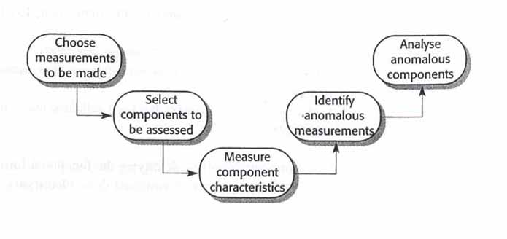
The Process of Product Measurement
1. Decide what data is to be collected
2. Assess critical (core) components first
3. Measuring component characteristics might require automated tools
4. Look for consistently (unusually only works in a factory) high or low values
5. Analysis of anomalous components should reveal if the quality of product is compromised

Slide 41
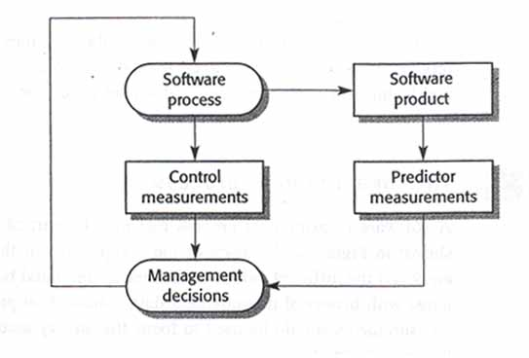
Predictor and Control Metrics
Examples of Predictor Analysis:
• Code Reuse: SLOC = ELOC = Ported Code
• Nesting Depth: ND > 5 = Low Readability
• Risk Analysis: # STR P1 > 0 at SAT = Low Product Reliability
Examples of Control Analysis:
• STR aging: Old STRs = Low Productivity
• Requirements Volatility: High Volatility = Scope Creep

Slide 42
Software Product Metrics
There are two categories of software product metrics:
1. Dynamic metrics – this metrics is collected by measuring elements
during program’s execution. This metrics help to asses efficiency and
reliability of a software product. The parameters collected can be
easily measured (i.e. execution time, mean time between failures)
2. Static metrics – this metrics is collected by measuring parameters of
the end products of the software development. This metrics help to
asses the complexity, understandability, and maintainability of a
software product. The SLOC size and ND are the most reliable
predictors of understandability, complexity, and maintainability.

Slide 43
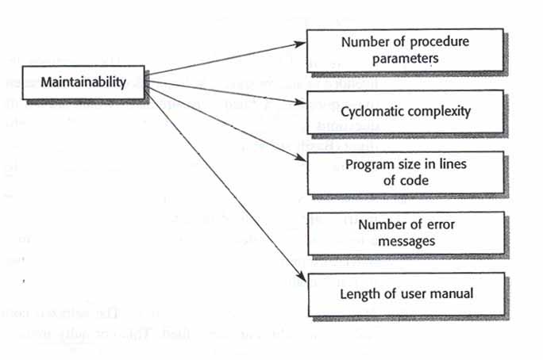
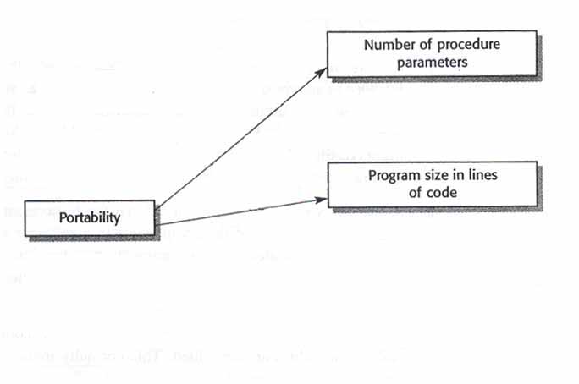
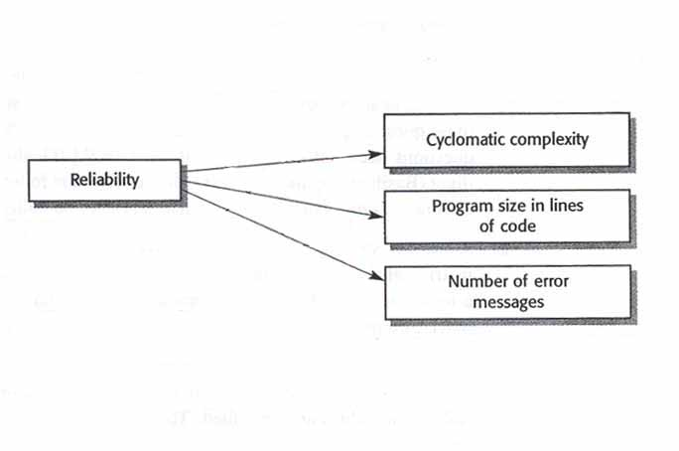
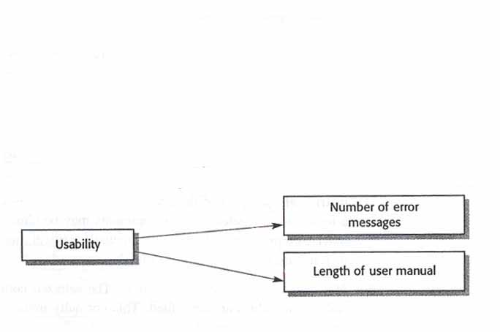
The Ilities
The specific metrics that are relevant depend on the on the project, the goals of the SQA, and the type of SW that is being
developed.

Slide 44
Defect Prevention
Defect Prevention – establishment of practices that lower the reliance
on defect detection techniques to find majority of the bugs
• Lessons learned – learning from other peoples experiences and sharing own experiences with the other projects
• Managing With Metrics – collecting the metrics, understanding it, and making changes to the product or process based on analysis. Metrics must be standardized to be effective.
• Risk Analysis – identifying potential risks and opportunities early in the program and tracking them to realization.
• Build freeze – no changes are made to the code during formal tests.
• Unit-level testing guidelines – test plans and procedures for each UT
• Baseline acceptance criteria – establishment of closure criteria in advance (i.e. no P1 STRs at FAT TRR)

Slide 45
To be continued… See you next week

